Slide 1
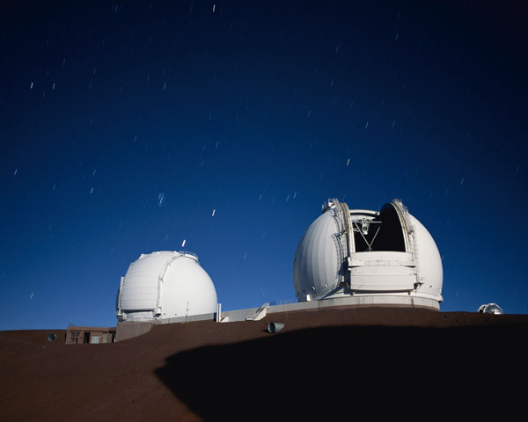
How NOT to write a Keck proposal
Swinburne Keck Technical Secretary: Jeff Cooke

Slide 2
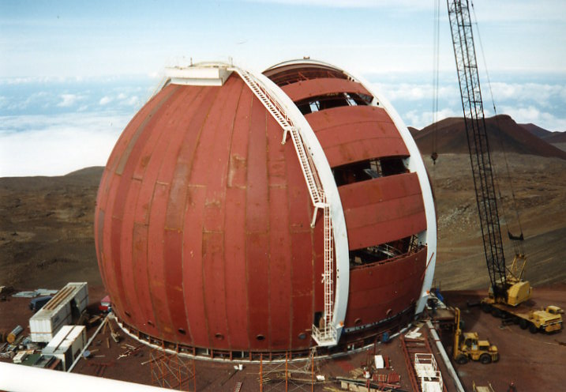

Slide 3
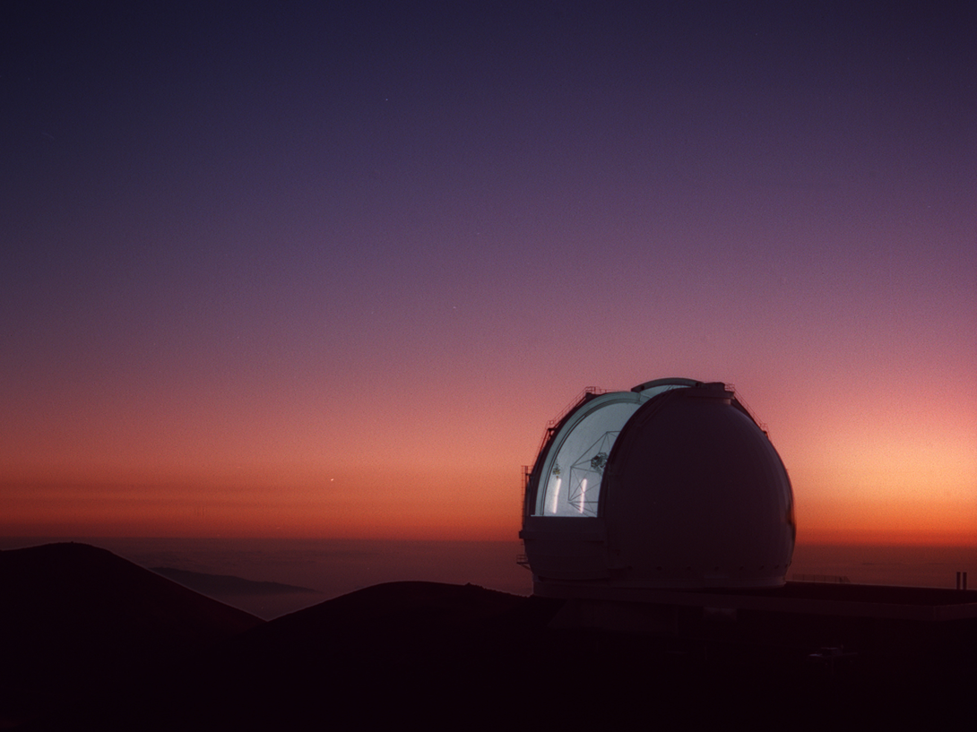
Keck 20th anniversary of First Science

Slide 4
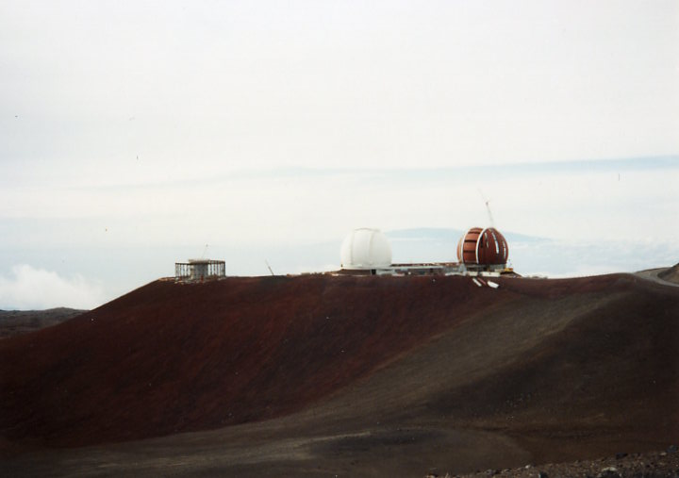
Keck 20th anniversary of First Science

Slide 5
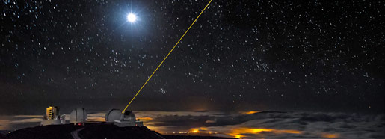
So, you want to write a Keck proposal?
Throughout this talk:
- The Swinburne proposal process
- Keck instrument info
- New proposal items starting this semester
- Things to consider
- Some tips for success

Slide 6
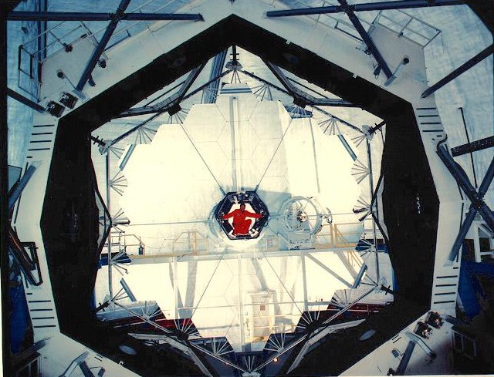
How NOT to write a Keck proposal
Big (expensive) light buckets

Slide 7
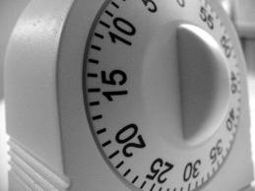



How NOT to write a Keck proposal
High-risk, high-impact science?
Typically 1 or 2 night proposals
Break-through science?
or paper?
9.25hr = $3 per second…
(and your) reputation is on the line

Slide 8
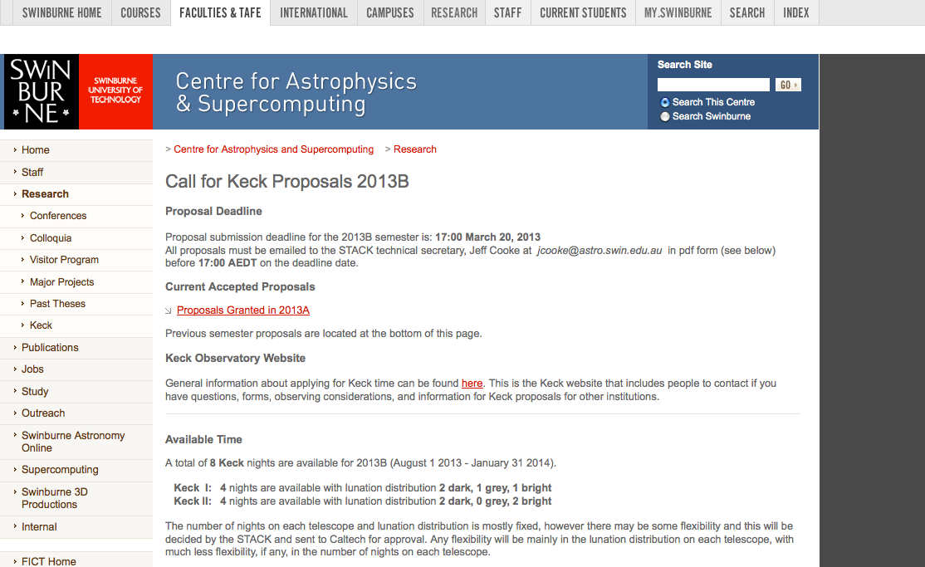
How NOT to write a Keck proposal
http://astronomy.swin.edu.au/research/keck/cfp.html

Slide 9
How NOT to write a Keck proposal
Policies and Procedures document
Read it
Know it
Live it
http://astronomy.swin.edu.au/research/keck/cfp.html

Slide 10
How NOT to write a Keck proposal
http://astronomy.swin.edu.au/research/keck/cfp.html

Slide 11
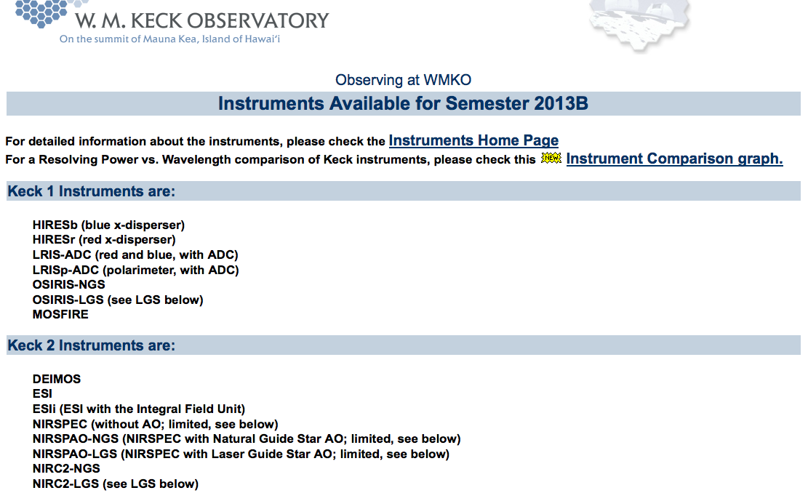
How NOT to write a Keck proposal

Slide 12
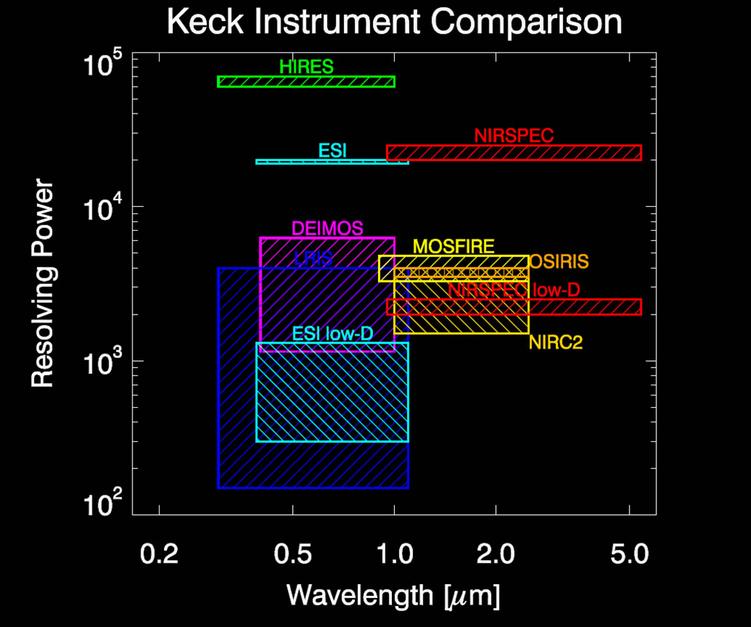

Slide 13
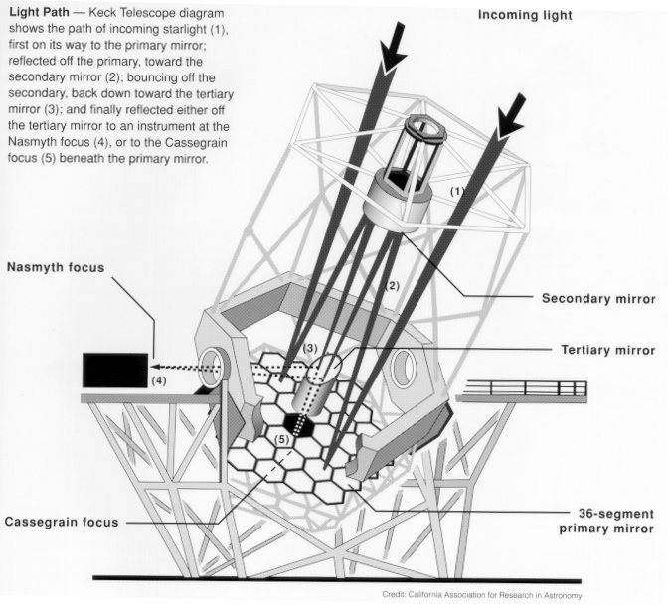
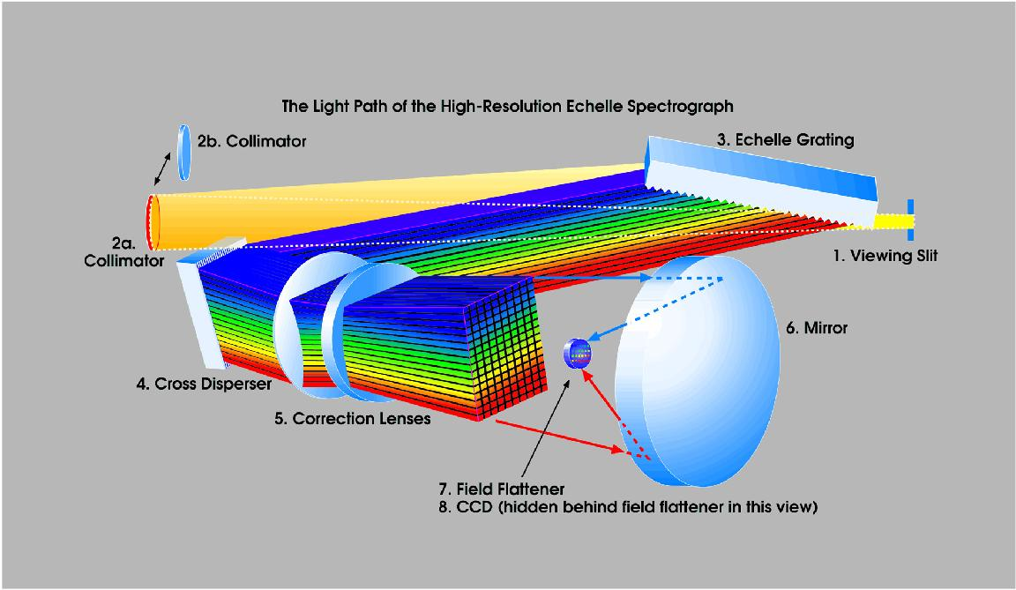
How NOT to write a Keck proposal
HIRES (Keck I) HIRESb; HIRESr

Slide 14
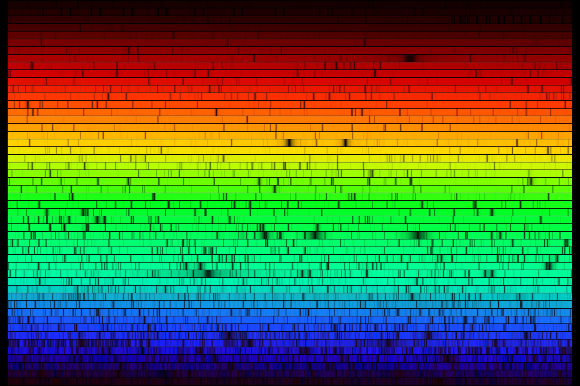
How NOT to write a Keck proposal
HIRES (Keck I) HIRESb; HIRESr

Slide 15
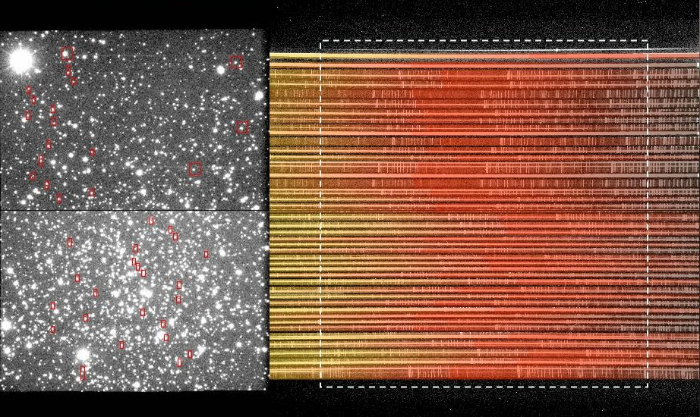
How NOT to write a Keck proposal
LRIS (Keck I) LRISb/r MOS; LRISp; imager ADC

Slide 16

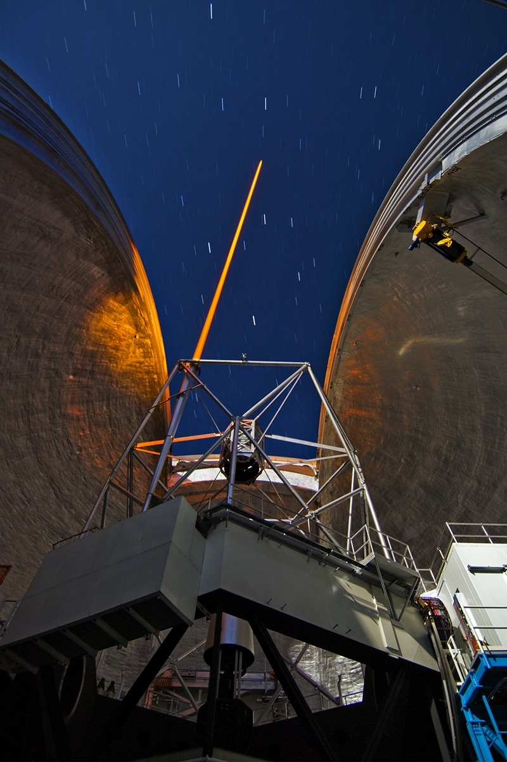
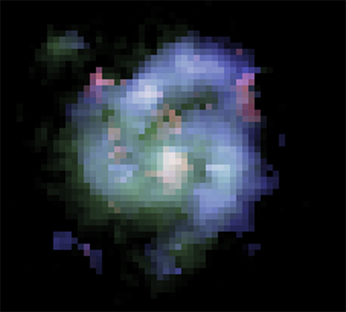
How NOT to write a Keck proposal
OSIRIS (Keck I) OSIRIS IFU; OSIRIS NGS/LGS

Slide 17
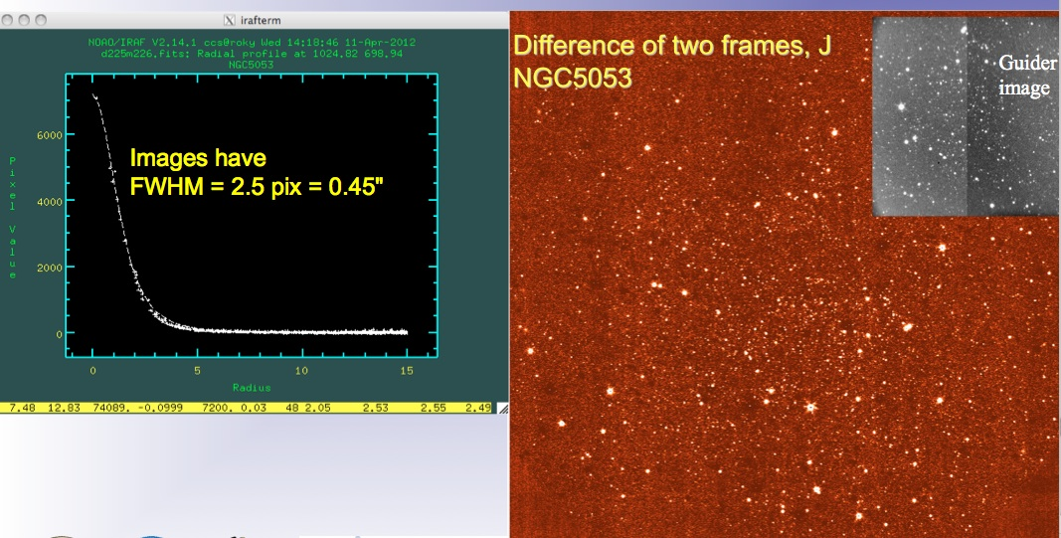
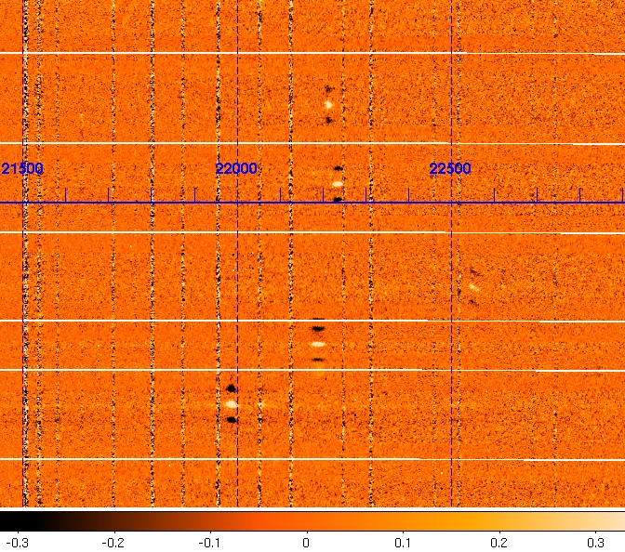
How NOT to write a Keck proposal
MOSFIRE (Keck I) MOSFIRE MOS; imager

Slide 18
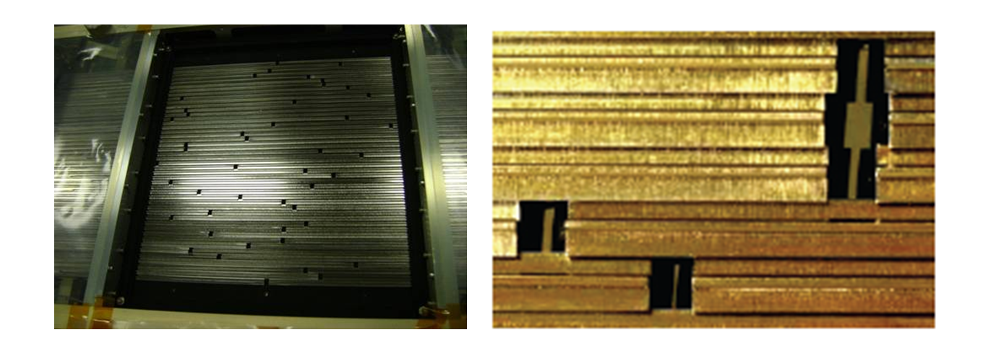
How NOT to write a Keck proposal
MOSFIRE (Keck I) MOSFIRE MOS; imager

Slide 19
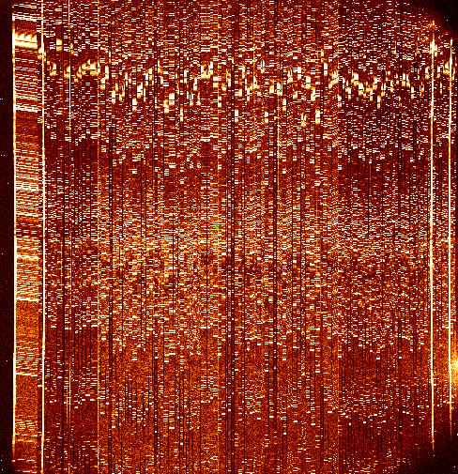
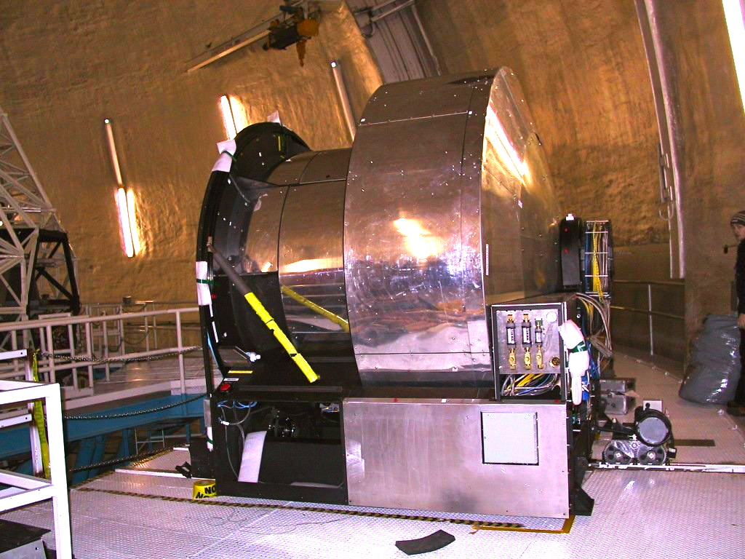
How NOT to write a Keck proposal
DEIMOS (Keck II) DEIMOS MOS; WF imager

Slide 20
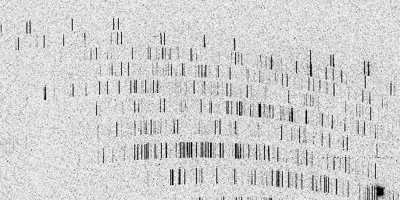
How NOT to write a Keck proposal
ESI (Keck II) ESI echelle/low-D; imager; IFU

Slide 21
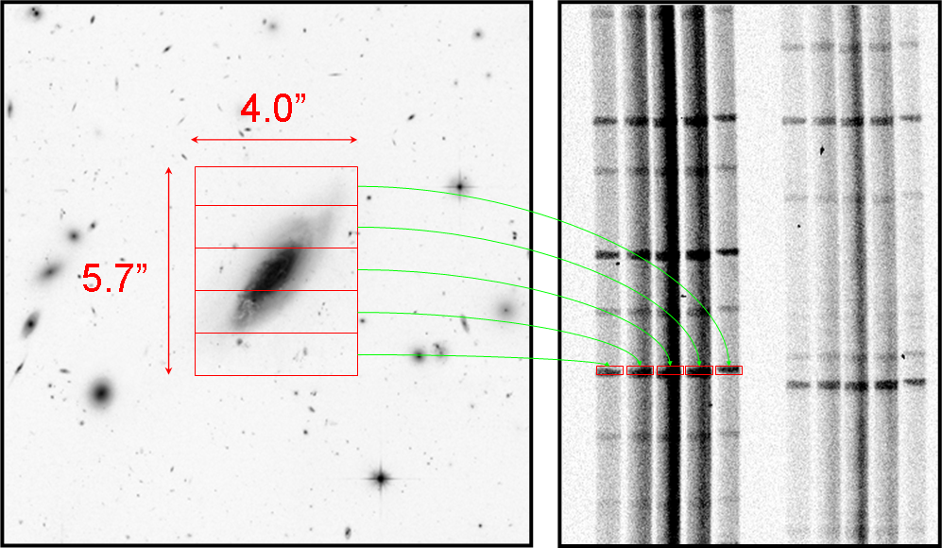
How NOT to write a Keck proposal
ESI (Keck II) ESI echelle/low-D; imager; IFU
Image slicer IFU

Slide 22
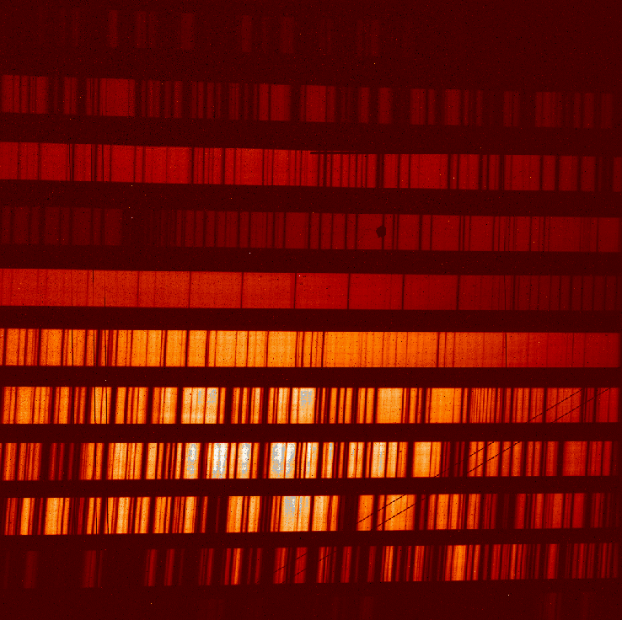
How NOT to write a Keck proposal
NIRSPEC (Keck II) NIRSPEC (hi/low-D); NIRSPAO-NGS/LGS

Slide 23
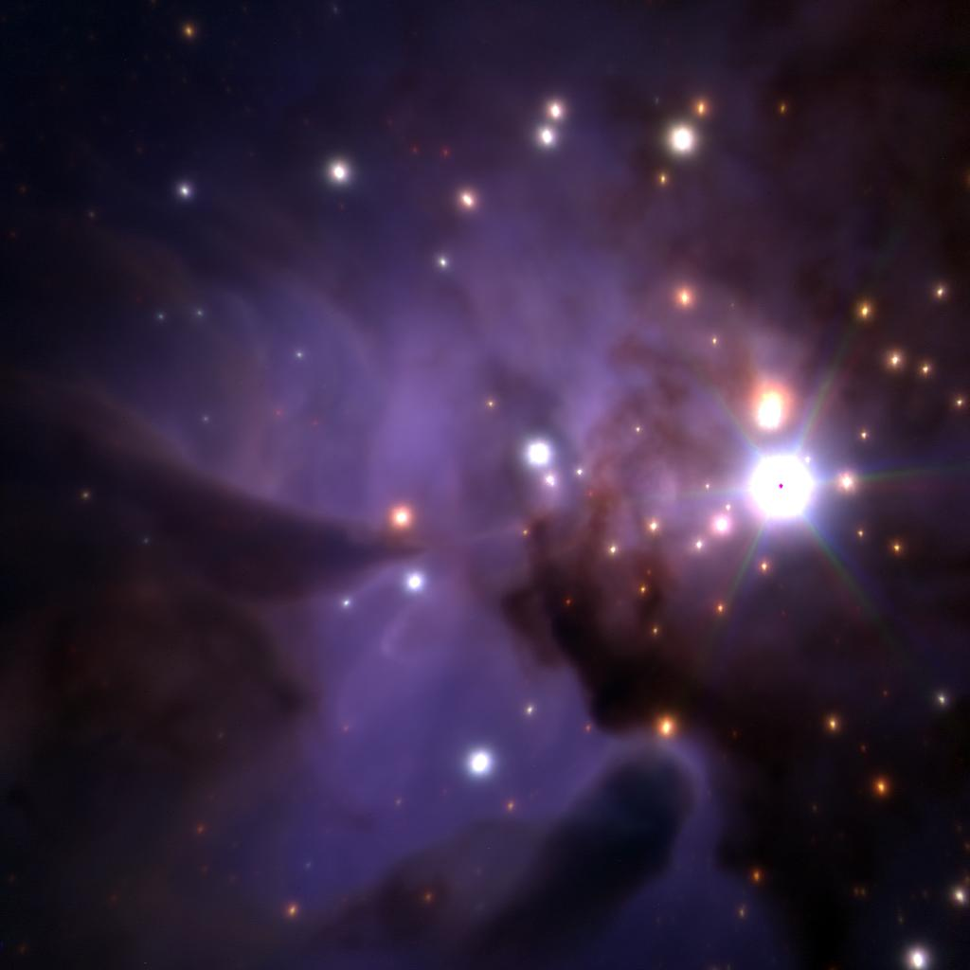
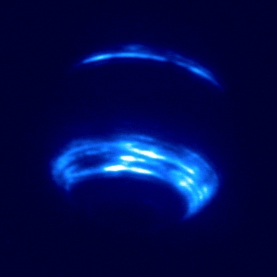
How NOT to write a Keck proposal
NIRC2 (Keck II) NIRC2 imager; NIRC2-NGS/LGS

Slide 24
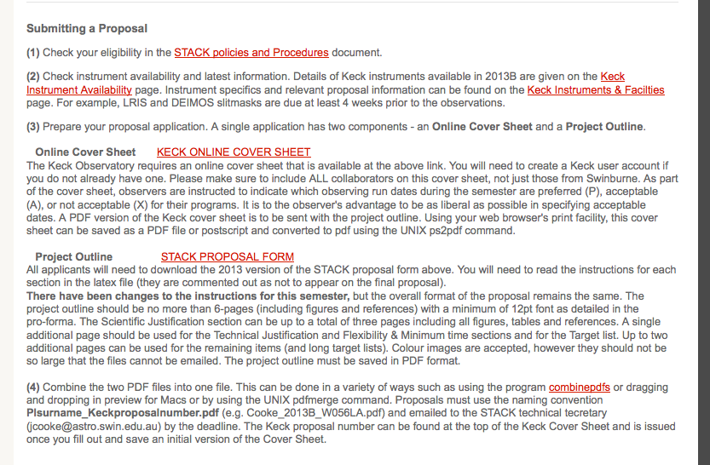
How NOT to write a Keck proposal

Slide 25
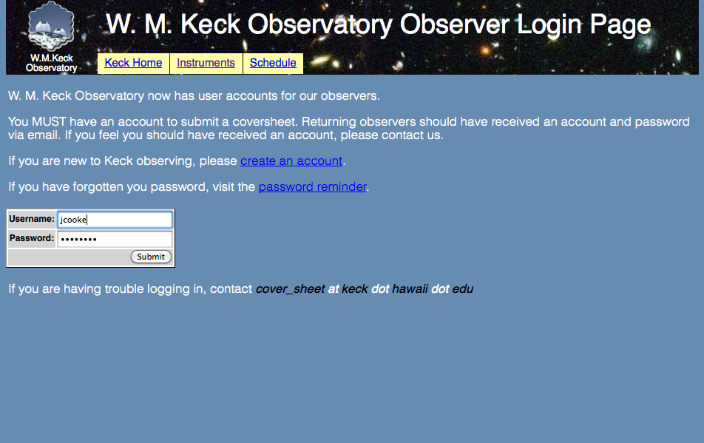
Keck cover sheet

Slide 26
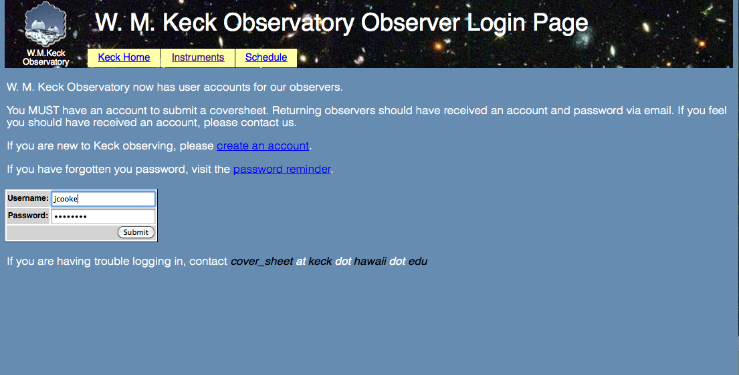
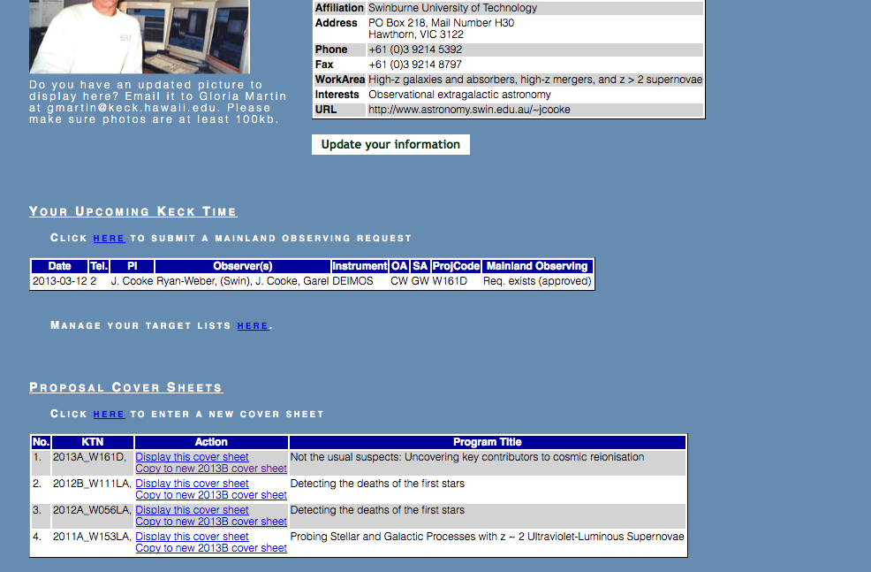
Keck cover sheet

Slide 27
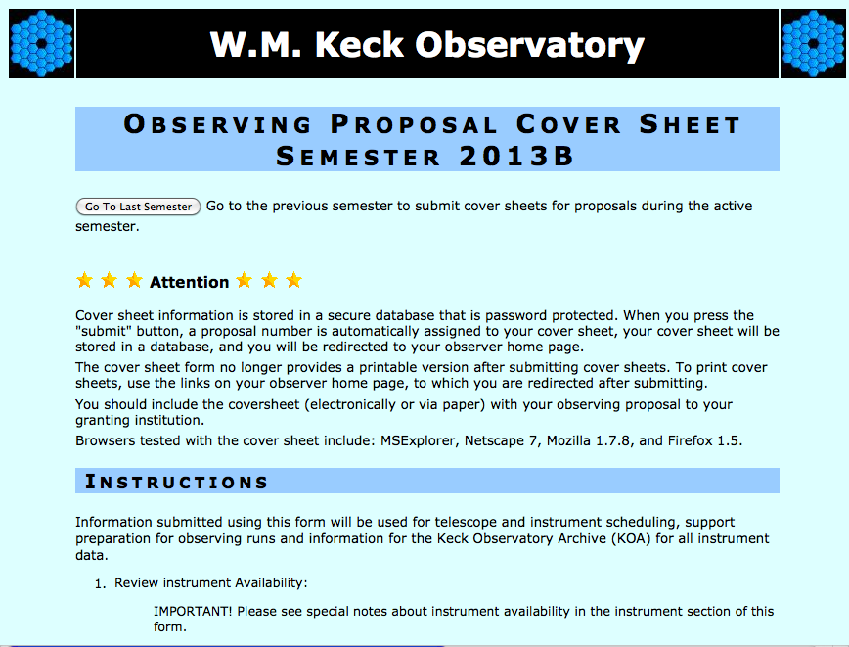

Slide 28
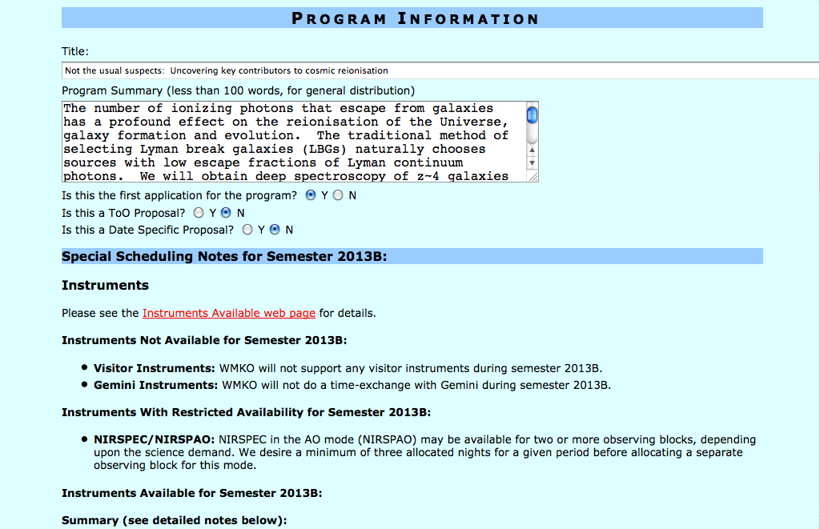

Slide 29
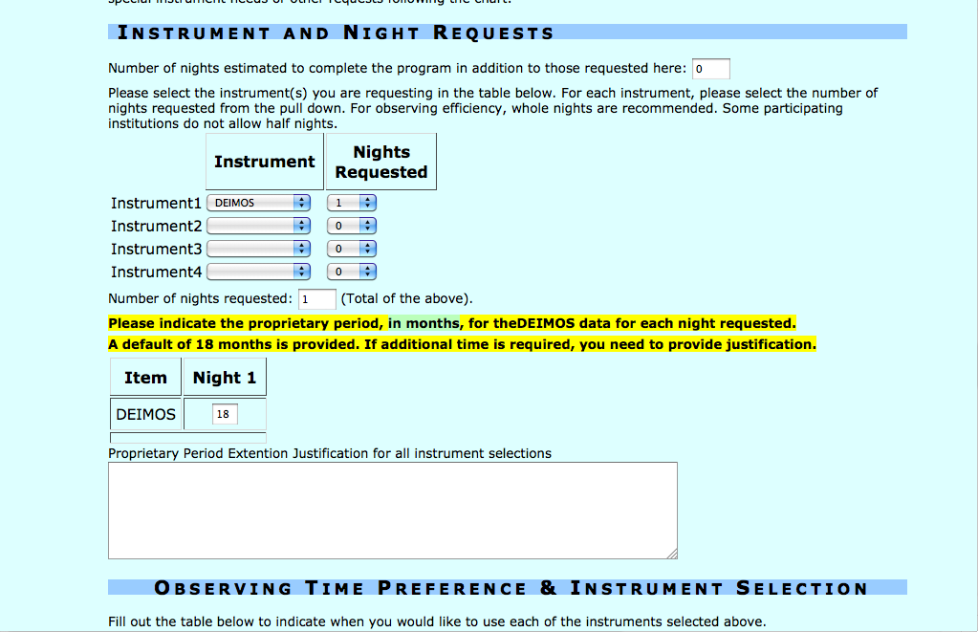

Slide 30
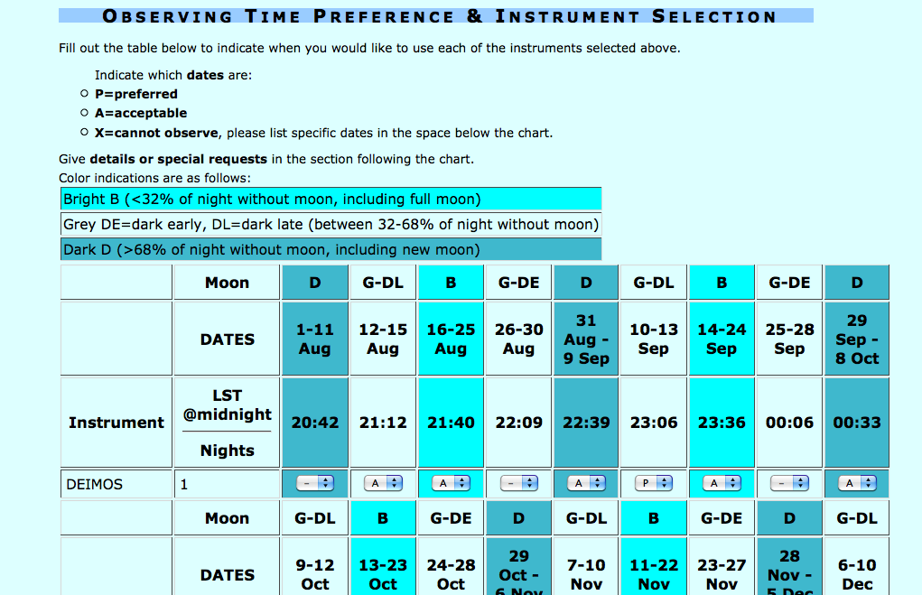

Slide 31
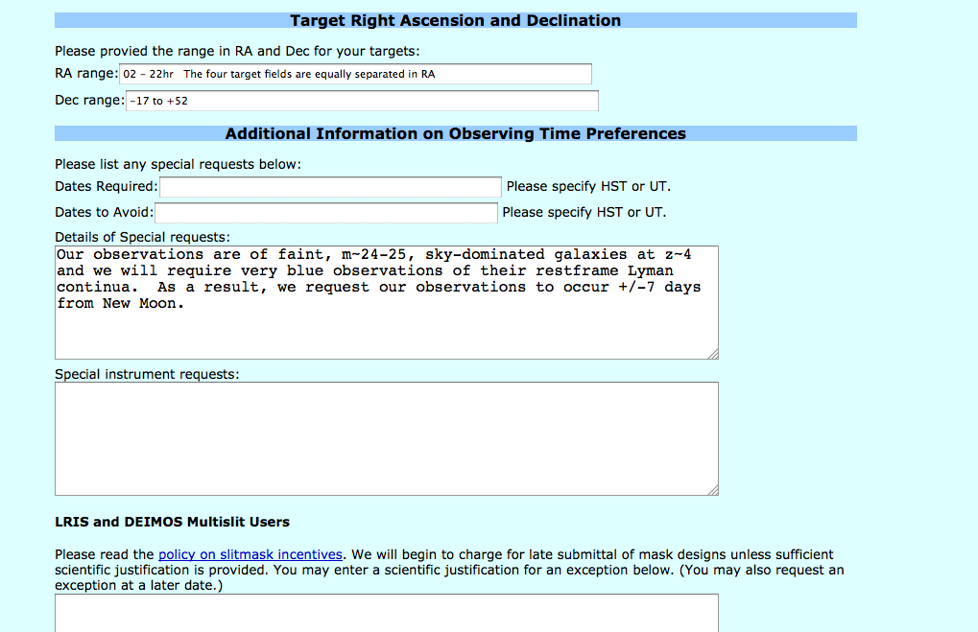

Slide 32
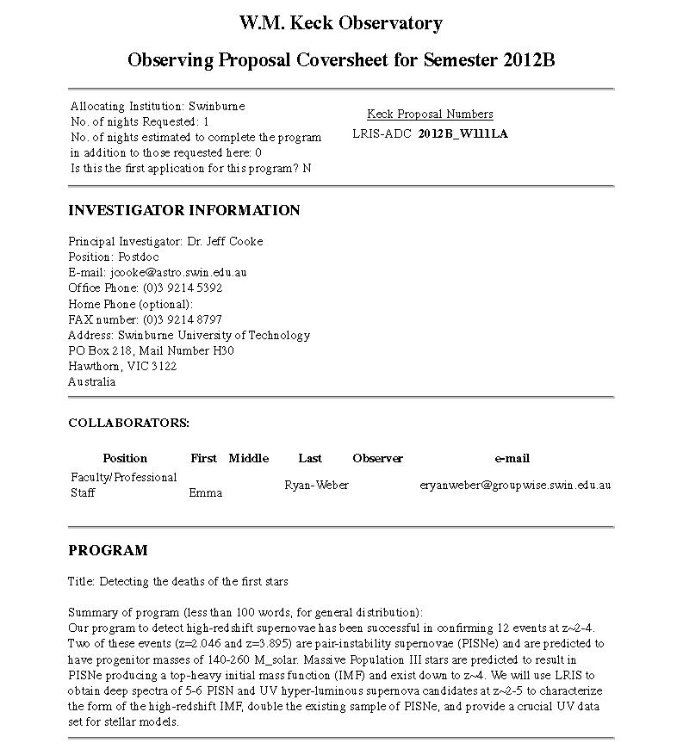
Keck cover sheet
Final proposal file naming
convention:
P.I.name_proposalnumber.pdf
e.g.,
Cooke_2012B_W111LA.pdf

Slide 33
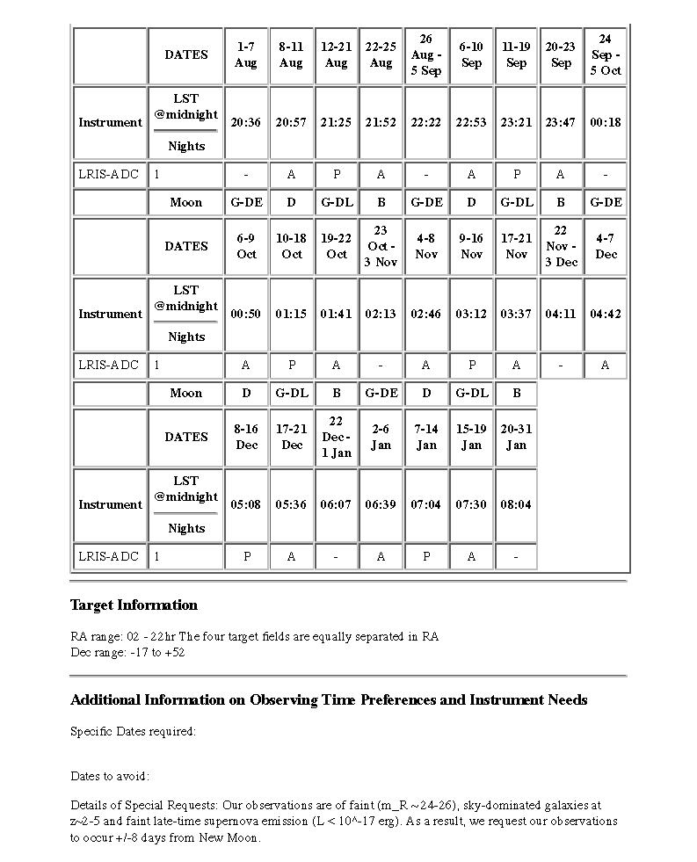
Keck cover sheet
Be as flexible as possible
to increase your chance
of scheduling success
BUT your objects must
be fully OBSERVABLE!

Slide 34
Keck cover sheet
Be as flexible as possible
to increase your chance
of scheduling success
BUT your objects must
be fully OBSERVABLE!
Include any scheduling
constraints here
For example:
Very blue observations, need
dark skies +/- 6 days from
New Moon
Cannot observe on Sept 3
(moon too close/collision)
Can only observe target from
Nov. 28 – 29 while planet
is in transit

Slide 35

How NOT to write a Keck proposal

Slide 36

Proposal Outline
Now the difficult part!
Scientific Justification
Figures 3 pages
References
Technical Justification
Flexibility & Minimum Time 1 page
Target List
(Extra Long Target List) (attach page)
Other Applications
Future Applications
Previous STACK Allocation Outcomes
Student Thesis Involvement 2 pages
Applicants Roles
Observing Experience
Backup Program

Slide 37
Proposal Outline
Scientific Justification
Clarity in what you want to do and how you will do it - WHY A 10-M TELESCOPE?
Write it at a level for an astronomer outside your field
MAU and TCBA: Minimize acronym usage; They can be annoying
Good idea to actually state the instrument and number of nights you are requesting
Keep this section clean and simple (try writing it in one page first)
Example of an effective outline:
- “Front load” what you are proposing
- Give sufficient background so the STACK members can appreciate what
you are proposing
- BUT… do not give too much background or area-specific details
- Judicious use of bold and italic fonts, numbers, and bullets (see this slide!)
- State the goals of the proposal (bullet points are actually good here)
- Explain how the proposed observations will yield the results you claim
- Short summary

Slide 38
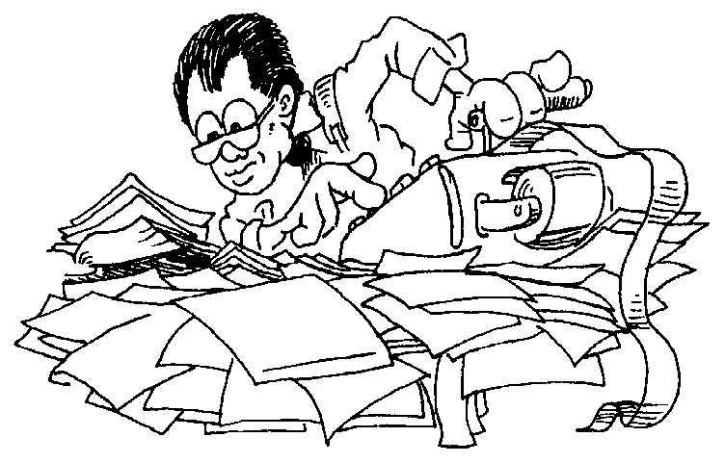
Proposal Outline
Still rather difficult!
Scientific Justification
Figures 3 pages
References
Technical Justification
Flexibility & Minimum Time 1 page
Target List
(Extra Long Target List) (attach page)
Other Applications
Future Applications
Previous STACK Allocation Outcomes
Student Thesis Involvement 2 pages
Applicants Roles
Observing Experience
Backup Program

Slide 39
Proposal Outline
Technical Justification
Most misunderstood section
All points below must be addressed
Describe why the instrument is the best choice
Include all relevant instrument setup details (grating angles, filters, slit widths, CCD binning, etc.)
State the number of nights. FULLY JUSTIFY exposure times and overhead calculations. Give typical example (justify) and/or extreme cases. The STACK should be able to reproduce your values with no further assumptions.
Detail the visibility of your targets. Make sure to consider Keck Nasmyth platforms (rising and setting). Include the amount of time targets are NOT observable
Must include a backup program. Treat this seriously (occurs quite often). Include all points above (albeit to somewhat less detail). STATE THE SCIENCE GOALS!
You must also fully justify the technical feasibility of any possible variations in the instrument, setup parameters etc. in the "Flexibility & Minimum Time" section

Slide 40
Proposal Outline
Flexibility & Minimum Time
Flexibility: Describe any aspect of your proposed observations which are flexible with respect to, for example, lunation, dates, instrument availability, instrument setting, distribution of time (e.g. multiple night gaps allowed) etc. Flexibility will aid the STACK, and Keck, in approving and scheduling your proposal.
Use the ETCs! Some are rather new
HIRES, (OSIRIS), MOSFIRE, DEIMOS, ESI, NIRC2
Minimum Time: State the minimum amount of time in which you can undertake your science. Proposers should keep in mind that SUT have a limited number of nights on Keck each semester and those nights must be distributed over each telescope and over bright/grey/dark time `fairly'.
Target List
Obvious, but use the format given in the LaTeX file. Long lists can extend to an additional page (can add on to the end of the proposal).

Slide 41

Proposal Outline
Keep in mind that throughout the proposal process, feel free to contact me is you have any questions and, in particular, if you have questions related to the Technical Feasibility section
jcooke(at)astro.swin.edu.au
or office phone ext. 5392

Slide 42
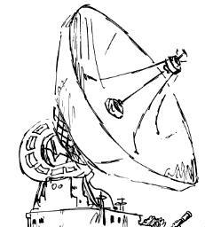
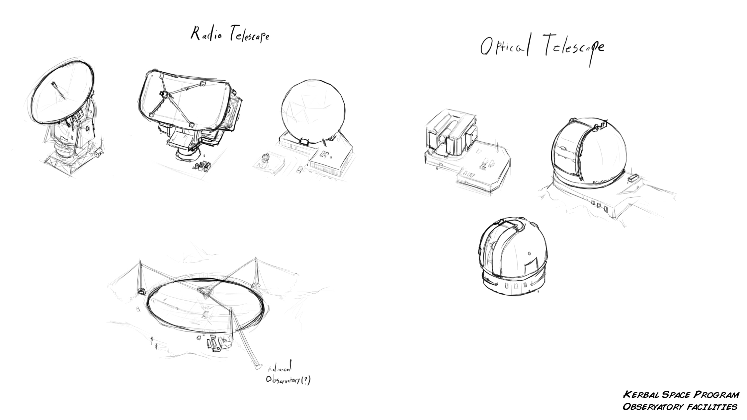
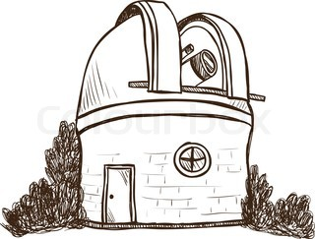
Proposal Outline
Not too difficult part
Scientific Justification
Figures 3 pages
References
Technical Justification
Flexibility & Minimum Time 1 page
Target List
(Extra Long Target List) (attach page)
Other Applications
Future Applications
Previous STACK Allocation Outcomes
Student Thesis Involvement 2 pages
Applicants Roles
Observing Experience
Backup Program

Slide 43
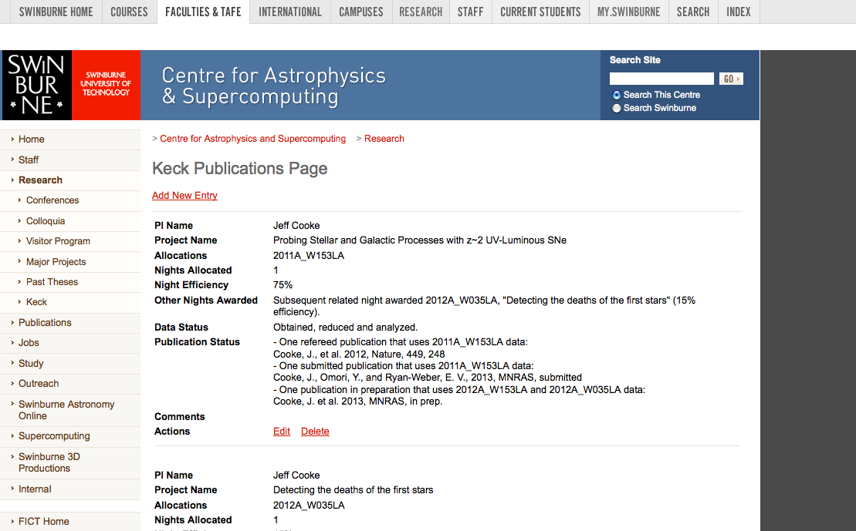
PI publication page
http://astronomy.swin.edu.au/research/keck_pubs/

Slide 44
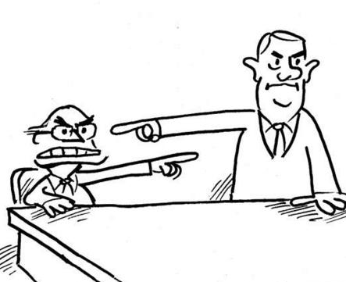
Proposal Outline
Not too difficult part
Scientific Justification
Figures 3 pages
References
Technical Justification
Flexibility & Minimum Time 1 page
Target List
(Extra Long Target List) (attach page)
Other Applications
Future Applications
Previous STACK Allocation Outcomes
Student Thesis Involvement 2 pages
Applicants Roles
Observing Experience
Backup Program

Slide 45


How NOT to write a Keck proposal
Want more nights on Keck?
Submit a Proposal for Caltech Collaborative Time
In the interests of promoting collaborative research between Swinburne and Caltech,
collaborations are to jointly apply to both of their respective time allocation committees
for Keck time for joint projects on an approximately equal time basis. If the proposed
joint project is not supported by both time allocation committees, the proposed project
will receive zero nights from either so that no party is disadvantaged and each time
allocation committee has a clear incentive to support their scientists when a genuine
desire to collaborate exists. Caltech will include a summary of Collaborative Time
allocations so PIs can make collaborative allocations informed by the program history.
The link to this summary will be provided here after this semester.
Swinburne and Caltech collaborations will need to apply to the STACK following the
guidelines described on this webpage and directly to the Caltech TAC. Caltech
Collaborative time proposals are due by 17:00 PDT, 2 April, 2013.

Slide 46
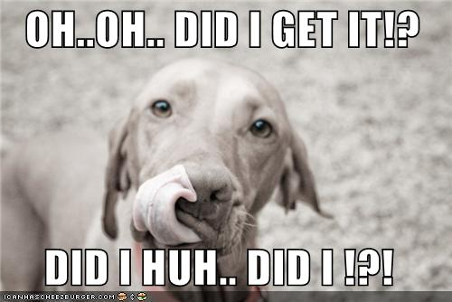
How NOT to write a Keck proposal
Proposal Outcomes
The STACK will meet in early April to review semester 2013B proposals. The STACK then puts forth their recommendations to Caltech. Proposers will learn of the results
late-April. The Keck telescope schedule
is released on 1 June.
Remote Observing/Eavesdropping
For those who wish to use the Swinburne remote facilities in "eavesdropping" mode, you must contact WMKO's Mainland Observing Coordinators and Jeff Cooke in advance of your run (4 weeks for mainland-only observing, 2 weeks for mainland eavesdropping mode). Currently, fully-remote (mainland-only) observing is not available but should be in the near future.
KOS Funds
The new travel forms are designed to accommodate travel funding requests for Keck runs. See the form, Liz, or me for details.

Slide 47
How NOT to write a Keck proposal
Questions?

